Slide 1
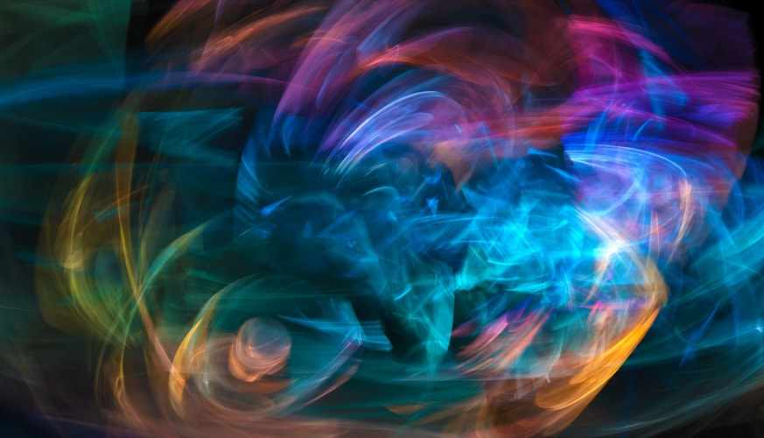
Music Generation with Neural Network Models
By: David Castillo

Slide 2
Problem Statement
Work as a data scientist for a manager of artists that depend on music sample backdrops. The manager is worried about the exponentially increasing expenses with clearing samples for his artists beats. If a model can generate new music from existing jazz works to have a bigger collection from which to sample from in house, we can scale up and create sounds with other genres. This could really help the finances of the business by decreasing the reliance of those expenditures. Could even be used to inspire artists in house to aid in creating organic sounds.

Slide 3

Background Research

Slide 4

Music

Slide 5
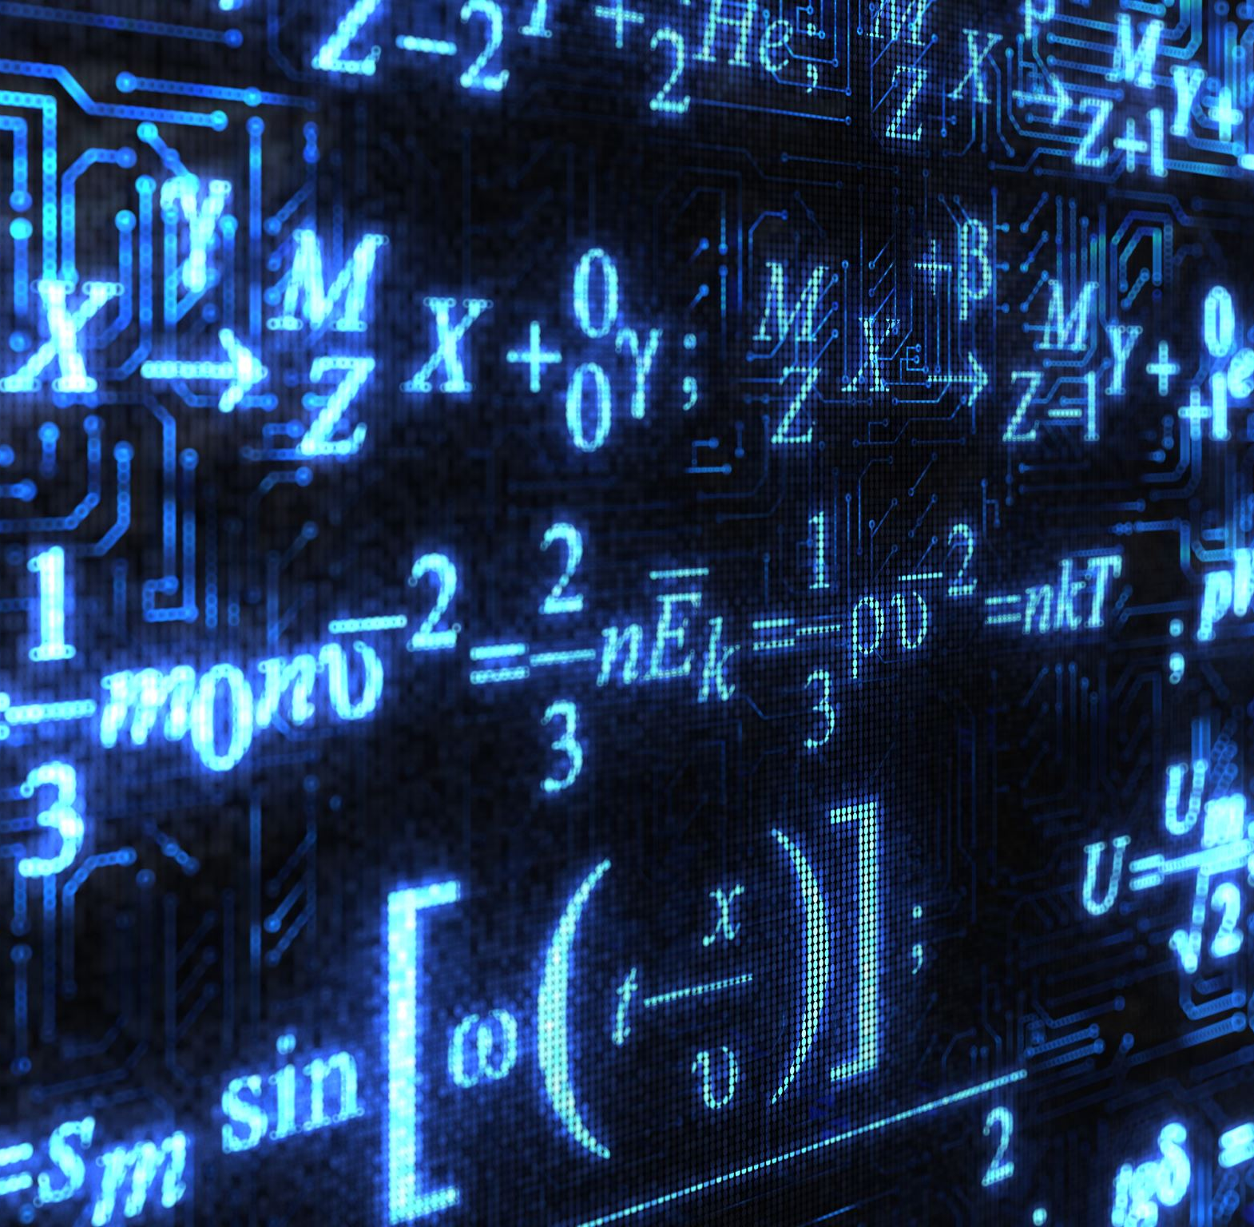
Music Theory and Mathematics

Slide 6

The dataset

Slide 7
